Slide 1
Lecture LA06: Validation
ITP271 Web Applications Development & Project

Slide 2
Overview
Validators
  RequiredFieldValidator
  RangeValidator
  RegularExpressionValidator
  CompareValidator
  ValidationSummary

Slide 3
Validation
Web applications are constructed to provide or gather information.
Collect valid data should be important when constructing a web application
Validation is a set of rules that applied to the data collected

Slide 4
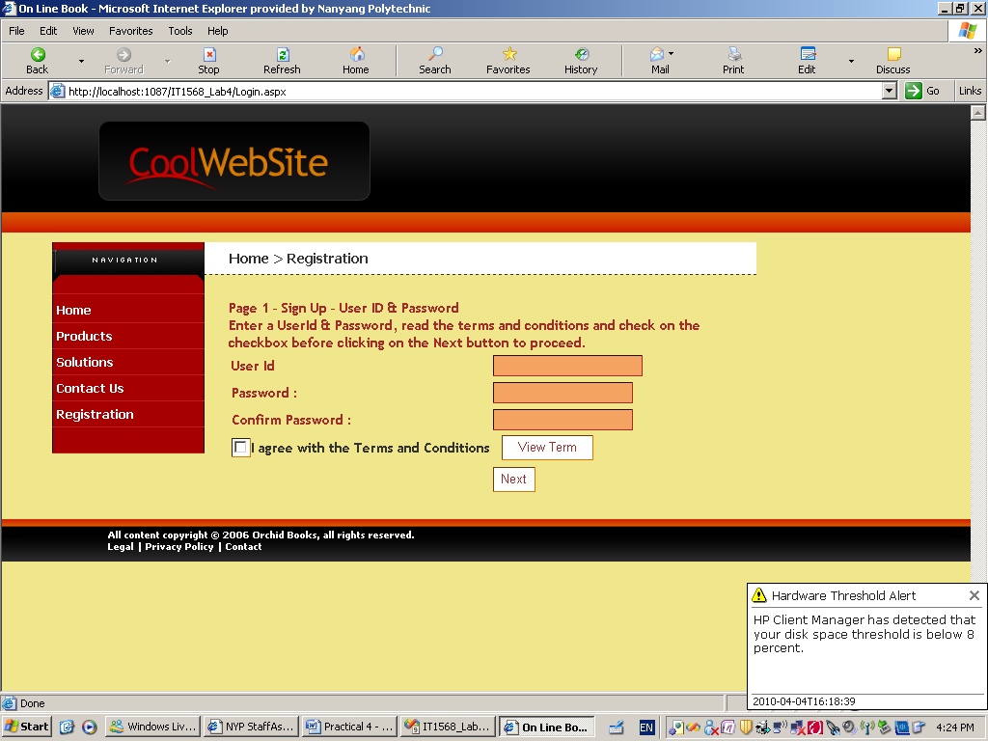
Cause Validation
Validation occurs when button, image button or link button is clicked.
If your page contains multiple buttons, every button will invoke the validation.
Set CauseValidation property in the button control to enable or disable the validation.
Unable the validation for View Term button by setting CauseValidation property to ‘False’ for View Term Button

Slide 5
ASP.NET Validation Server Control
Validation Control | Usage
RequiredFieldValidator | Ensure user does not skip input
CompareValidator | Compare between user input and other item
RangeValidator | Check user input base on lower and upper range defined in the control
RegularExpressionValidator | Check user input match a pattern defined
CustomValidator | Check user entry using costumed code validation
ValidationSummary | Display all error message in one specific spot on the page

Slide 6
Attribute of validation server control
Control | Description
ControlToValidate | The ID of the input control that the validation control will evaluate.
Display | None — The validationcontrol is never displayed inline. Static — The validation control displays an error message if validation fails. Space is reserved on the page for the message even if the input passes validation Dynamic — The validation control displays an error message if validation fails. Space is not reserved if input passes validation.
ErrorMessage | The error message to display in the Validation control if validation fails.
Text | When set, this message is displayed in the validation control when validation fails. If this property is not set, the text specified in the ErrorMessage property is displayed in the control

Slide 7
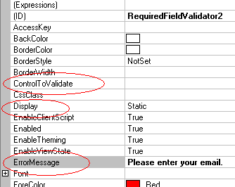
RequiredFieldValidator
When a textbox control is bind to this validator, user must enter some value into the text box.
Important setting
  ControlToValidate
  ErrorMessage
  Display
  Text

Slide 8
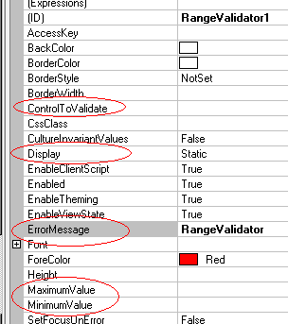
RangeValidator
Use to ensure input control values is within a range of specified minimum and maximum value
Important setting
  ControlToValidate
  ErrorMessage
  Display
  Min and Max

Slide 9
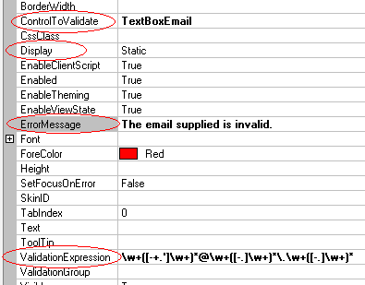
RegularExpressionValidator
A very flexible validator that make use of regular expression
Important setting
  ControlToValidate
  ErrorMessage
  Display
  ValidationExpression

Slide 10
RegularExpressionValidator
What are Regular Expressions?
Regular Expressions are a powerful pattern matching language.
Regular Expressions allow you to apply a pattern to an input string and return a list of the matches within the text.
Regular expressions also allow text to be replaced using replacement patterns.

Slide 11
RegularExpressionValidator
Visual Studio comes default with a number of validation expression for e.g. email, zip code etc.
Example U.S Social Security Number
  \d{3}-\d{2}-\d{4}
  The above expression use on a text box make sure user enters the following format NNN-NN-NNNN i.e. 3 digits – 2 digits – 4 digits

Slide 12
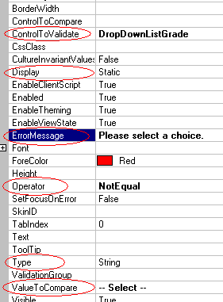
CompareValidator
Use to compare the value of a control with:
  Value of another control (ControlToValidate property), OR
  Value in ValueToCompare property
Important setting
  ControlToValidate
  ErrorMessage
  Display
  Operator
    Valid if this is TRUE
  Type
  ControlToCompare
  ValueToCompare

Slide 13
ValidationSummary
Displays all the ErrorMessages of all validators within the web form.
If a ValidationSummary control is present on the page, all Validators will display their ErrorMessage property in 2 places.
  In their own location.
  In the validation summary.
To prevent Validators from displaying the ErrorMessages in both places, set the Text property of the validator (usually) to a symbol like '*' or number to indicate the location of the error.

Slide 14
Summary
With validator controls, we can validate user input without complex coding.
In the lab, we will continue with our previous lab where we create a feedback form and use the validators to validate user input.

Slide 15
References
Regular Expression

